Slide 1


Amazon Last Mile Routing
Research Challenge Team
Adam Catalfano, Ishan Kaul, Elena McQuay, Alex Nelson

Slide 2
Challenge Objective
Build a model that uses known delivery data and historically observed high, medium- and low-quality route sequences to propose high-quality route sequences for new deliveries for which no observed route sequence is known yet.

Slide 3
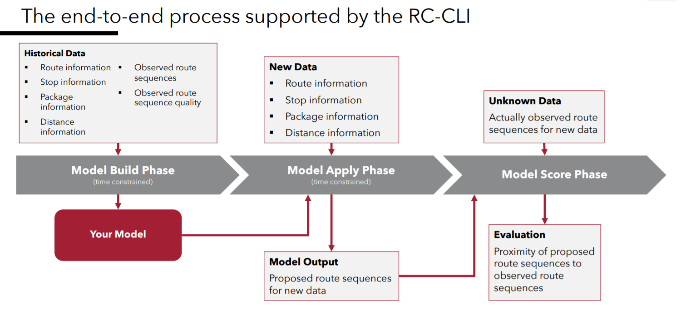
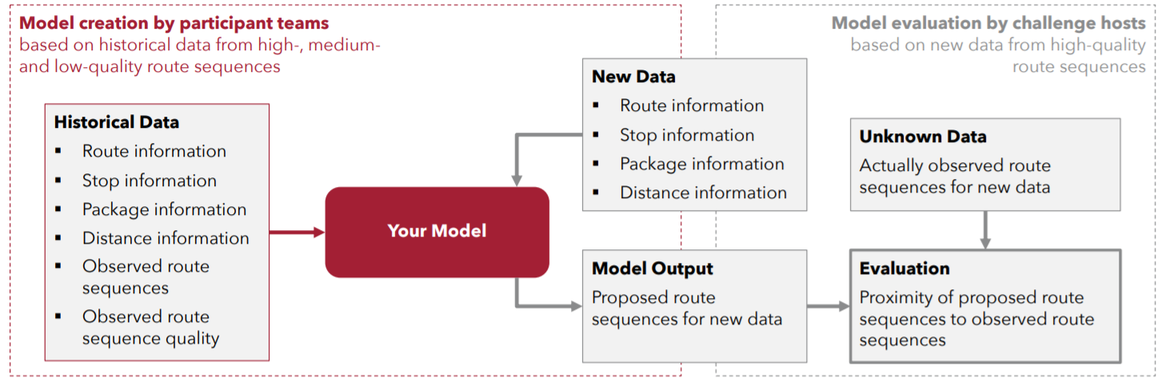

Slide 4
Research Teams
data
Application
Theoretical Approaches

Slide 5
Data Team
Evaluate historical data
Identify patterns and trends

Slide 6
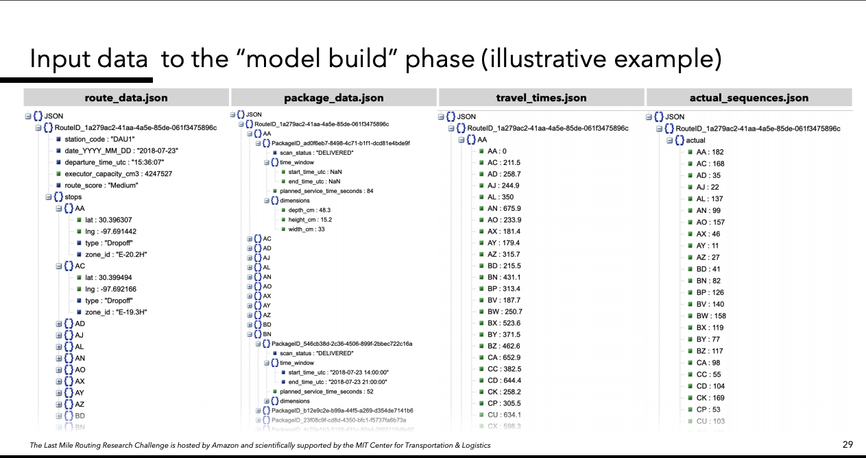

Slide 7
Application Team
Evaluate additional tools to be applied to solution
Review and understand the tools provided by the challenge
Notes:
PyTorch vs. TensorFlow vs Theano
Rc-cli
Scoring system

Slide 8
Theoretical Approaches Team
Determine algorithm needs to produce desired output model
Review data and constraints
Notes:
Hierarchical categorical approach of machine learning

Slide 9
Questions?

